Slide 1
Coding Theory
Kaman Phamdo
Mentor: Sean Ballentine
December 9, 2015

Slide 2
What is a code?
A code converts information into another representation
Used for communication through a channel
How computers communicate
Encoding
Decoding

Slide 3
What is a code?
message source
receiver
source encoder
channel
source decoder
NOISE
Notes:
in practice, talk about computers

Slide 4
Example 1
We → 00
love → 01
laugh → 10
math → 11
Suppose we wanted to send the message “We love math”...

Slide 5
Example 1
We → 00
love → 01
laugh → 10
math → 11
We love math
We love laugh
00 01 11
channel
00 01 10
no error detected
NOISE

Slide 6
Error-Detecting Codes
ISBN (book numbers) - a 10-digit code used to uniquely identify a book
Last digit is a check digit used for error detection
Error-detecting but not error-correcting

Slide 7
Error-Correcting Example
We → 00000
love → 00111
laugh → 11001
math → 11110
Suppose we wanted to send the message “We love math” again,
but this time using a longer length for code words.

Slide 8
Error-Correcting Example
We → 00000
love → 00111
laugh → 11001
math → 11110
We love math
We love math
00000 00111 11110
channel
00000 00111 11111
error detected (maximum
likelihood choice is “math”)
NOISE

Slide 9
Error-Correcting Codes
Need to detect and correct errors due to noisy channels
Can be more expensive and less efficient
We want good error-correcting capabilities and transmission rates
Coding theory examines transmission of data across noisy channels and recovery of corrupted messages

Slide 10
Hamming Distance
Let x and y be words of length n over alphabet A. The Hamming distance d(x,y) is the number of places at which x and y differ.
We can define a minimum Hamming distance for a code
Larger minimum distance = better error-correcting capability

Slide 11
Linear Codes
A linear code is an error-correcting code in which each linear combination of codewords are also in the coding alphabet
Linear codes are vector spaces
Easier to encode and decode
Example: A = {000, 001, 010, 011}

Slide 12
Encoding Linear Codes
Let C be a binary linear code with basis {r₁ . . . r_{k}}
C can represent 2^{k} pieces of information (words)
Any codeword u can be written uniquely as: u₁r₁ + . . . + u_{k}r_{k}
The process of representing these elements is called encoding

Slide 13
Decoding Linear Codes
For non-linear codes, decoding can require exponential computing
This is why we want linear codes to use in practice
Nearest neighbor decoding: simple algorithm for decoding linear codes

Slide 14
The main coding theory problem
Three parameters
d - Minimum (hamming) distance
n - Length of code words
M - Size of coding alphabet
Given a fixed n and d, what is the largest possible size M that a code can achieve?
We also examined fixing the other two parameters
Notes:
introduce computational approach with the program

Slide 15

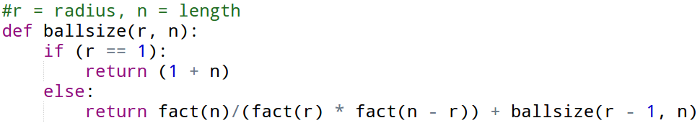
Hamming Ball
For alphabet A, a ball of radius r and center u is the set of vectors in A that have a distance ≤ r from center u.
The size of a ball of radius r and vectors of length n is given by: (for a binary code)

Slide 16
Our Approach
Used Python to create computational algorithm
Created a list to hold our optimal code and added 0 vector
Generated a code that included each possible vector of at least distance d
Continued until we had every possibility
Kept track of best choice

Slide 17
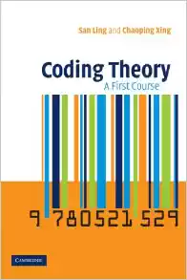
More on Coding Theory
Other possible paths:
Nonlinear codes
Nonbinary codes
Coding Theory: A First Course - San Ling, Chaoping Xing

